Slide 1
DESIGN THE CHANGE
ESTELA, NINA, ISAAC, ALESSIO AND DRAGANA

Slide 2

Poster – Break the Hate! Build Respect!
Designed by: Isaac

Slide 3


Bookmark – Don’t Judge People by What You See
Designed by: Estela & Alessio

Slide 4
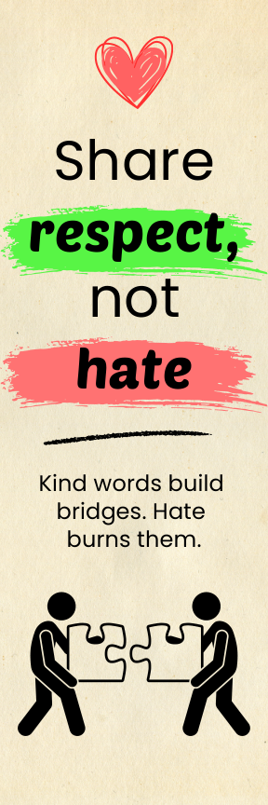
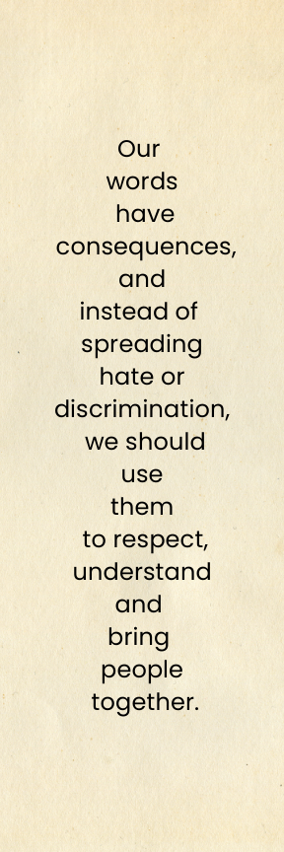
Bookmark – Share Respect, Not Hate
Designed by: Estela & Alessio

Slide 5
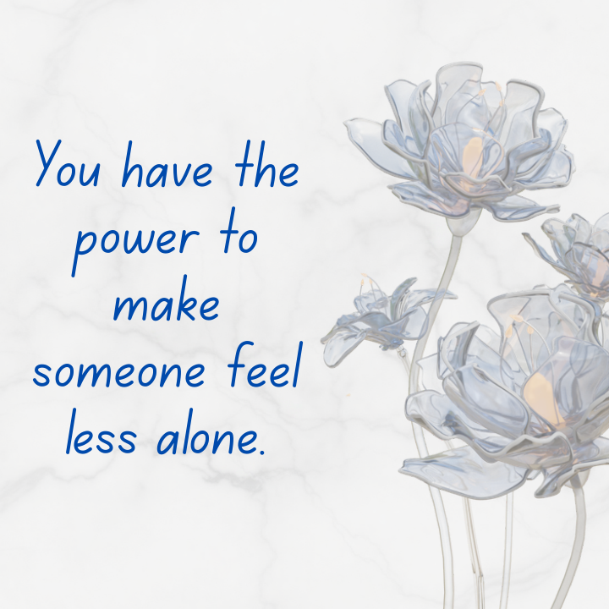
Message Card – You Have the Power
Designed by: Nina

Slide 6

Message Card – Everyone Deserves Respect
Designed by: Nina

Slide 7
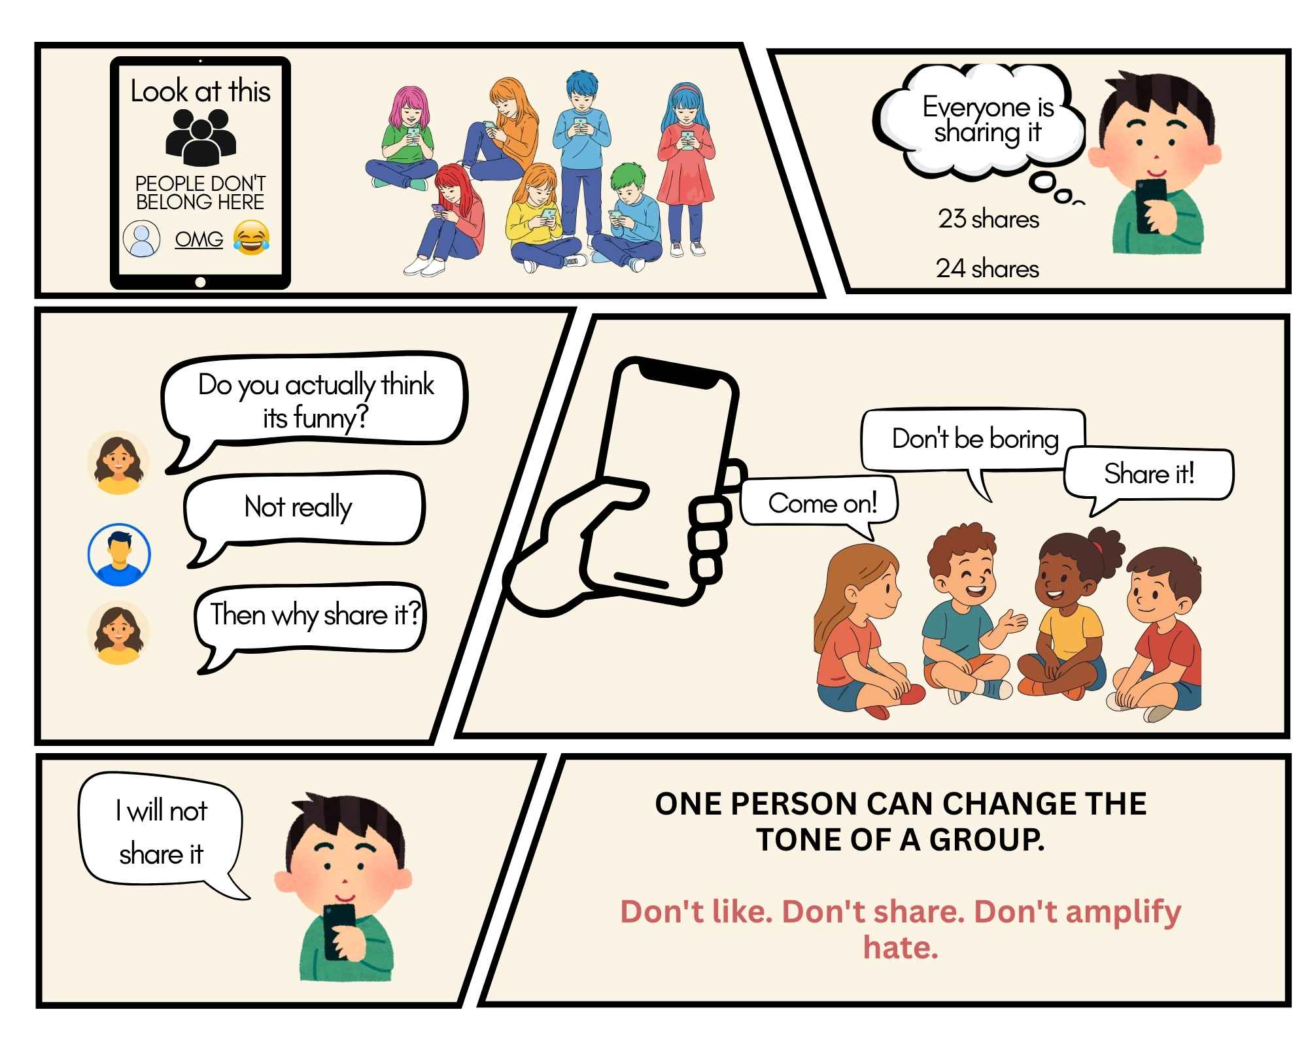
Comic Strip – Everyone Is Sharing It (for kids)
Designed by: Isaac

Slide 8
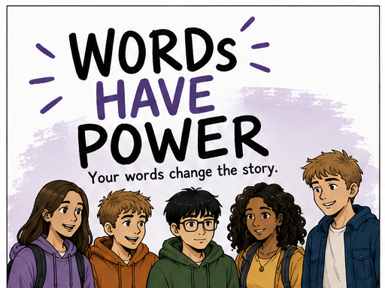
Comic – Cover (for young people and adults)
Generated by AI

Slide 9
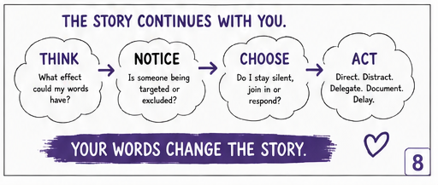
The Story Continues With You

